Slide 1
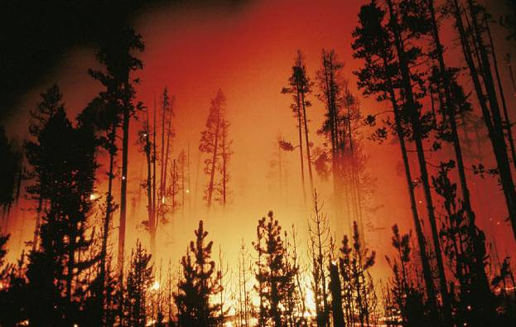
Natural disturbances and Forest Dynamics

Slide 2
Textbook
Chapin, Matson, and Vitousek, 2011
Principles of Terrestrial Ecosystem Ecology
Part III – Patterns
Chapters: 12-13
Springer-Verlag

Slide 3
Temporal Dynamics
Ecosystems are always recovering from past changes.
Ecosystem processes constantly change in response to variation in environment over all time scales.
Many time scales: interannual, annual and more
Steady state (very seldom): no directional changes in the properties of vegetation

Slide 4
Fluctuations - Modifications
Daily (photosynthetic activity);
Seasonal (Vegetation and dormancy);
Weather;
Interannual 1. Environmental (Climate)
2. Internal (Insects)
Long-term (Soil-use changes; Glaciations)
Disturbances
Predictable
Less
Predictable

Slide 5
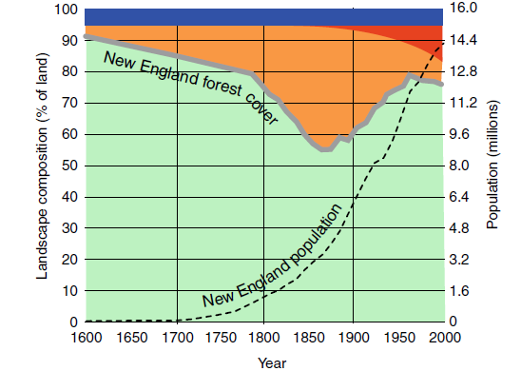
Long-term Fluctuations
Changes in land use and population density in New England (northeastern United States) since European colonization. Most land that was cleared for agriculture by 1850 has regrown as forest or, more recently, been developed as cities and suburbs (Foster et al. 2010).

Slide 6
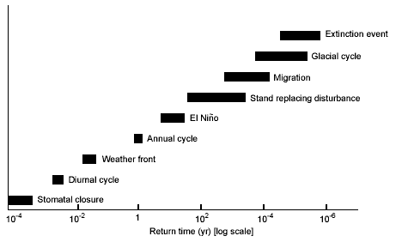
Temporal Dynamics
The key to temporal scaling of ecosystem processes is finding the correct driving variables that work at the temporal scale of interest.
Variation in return time for variables that strongly affect ecosystem processes. For any particular process, such as NPP, there are fast variables like stomatal closure that can be ignored, slow variables like El Niño or stand-replacing disturbance that strongly affect the process, and extremely slow variables, such as glacial cycles that can be treated as constants

Slide 7
Disturbances- Definitions
Disturbance: a relatively discrete event in time and space that alters the structure of populations, communities, and ecosystems and causes changes in resource availability or the physical environment (White and Pickett 1985).
Natural disturbance is a major cause of long-term fluctuations in the structure and functioning of ecosystems. (Chapin III 2004).
Natural disturbance: any process that causes a sudden decrease in standing live biomass and frees up ecological resources (Sousa, 1984).

Slide 8
Disturbances- Definitions
Disturbance is difficult to define unambiguously
Disturbance must be defined in the context of the normal range of environmental variation that an ecosystem experiences. The dividing line between disturbance and normal function is somewhat arbitrary.
Insects
Infestation
Dimensions, intensity, frequency
Disturbance
Limiting factor
Sporadic Costant

Slide 9
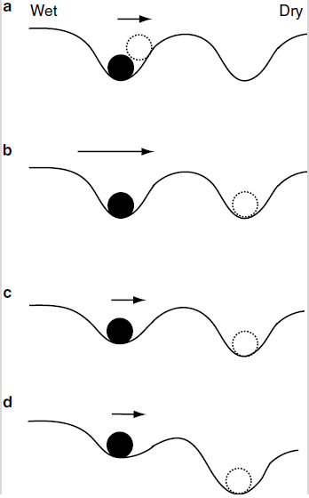
Disturbances…. more definitions
Resistance: describes the system tendency to remain in its reference state in the face of a perturbation; in ecological terms resistance is the capacity of a system to maintain certain structures and functions despite disturbance.
Resilience: denotes elasticity, or the rate at which a system returns to a reference state following perturbation. Is the capacity of a system to maintain its functions and structures in the face of one or several disturbances.
The response of any system to a perturbation (i.e., a external force that displaces the system from equilibrium) can be described in terms of a few general properties.
The response: describes the direction and magnitude of change in the system after a perturbation.

Slide 10
Disturbances – The recovery and succession
The recovery of a system describes the extent to which it returns to its original state after perturbation.
After disturbance, ecosystems undergo succession, a directional change in ecosystem structure and functioning resulting from biotically driven changes in resource supply.
Succession
Succession involves a change from a community governed by the dynamics of colonization to one governed by competition for resources.

Slide 11
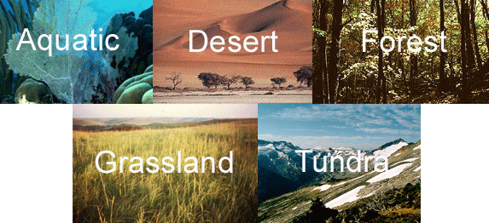
Disturbances – The recovery and succession
Broad global and regional patterns in ecosystem processes:
Climate Soils Topography
disturbance regime and post-disturbance succession
account for many of the local patterns of spatial variability

Slide 12
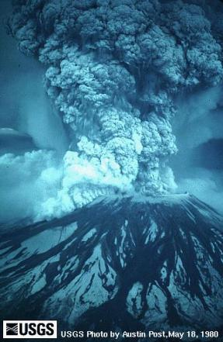
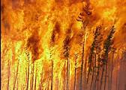
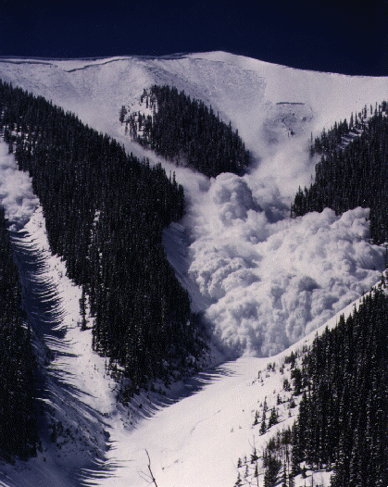
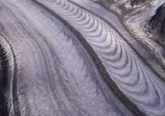
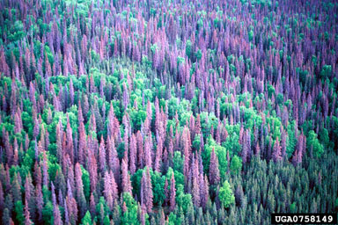
The successions
Successional changes occurring over decades to centuries explain much of the local variation among ecosystems.
Primary
Secondary

Slide 13
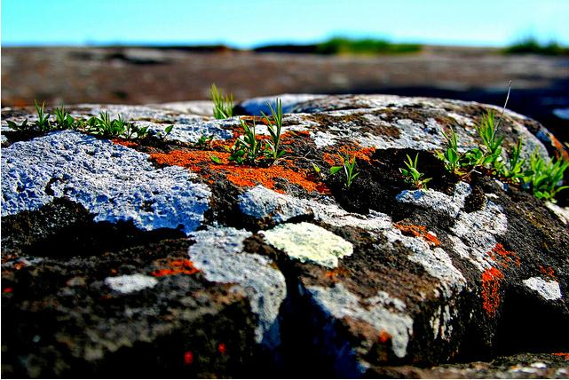
Primary succession
- Soil is extremely poor: species with symbiotic nitrogen fixation. Facilitation.
- No plant or propagules. All individuals must disperse to the site. Wind.
- Long process

Slide 14
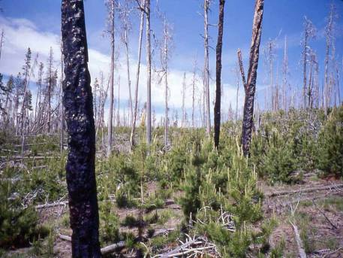
Secondary succession
- Soil is present. Pulse in nutrient availability
- Colonizers are already present. Resprout from roots and stems. Seed bank or seedling bank.
Change in species composition affected by:
Life-history traits of the colonizers;
Facilitation;
Competitive interactions;
Herbivory & pathogens;
Random processes.

Slide 15
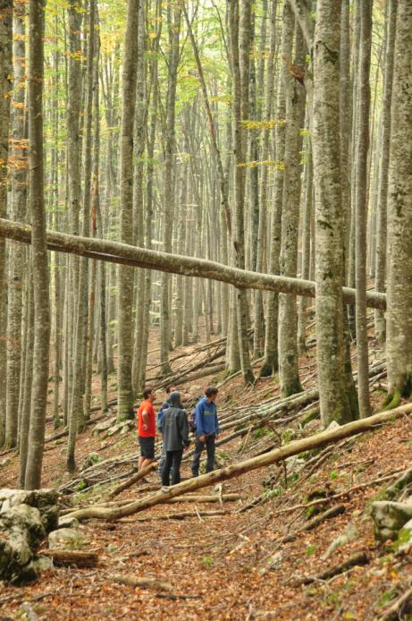
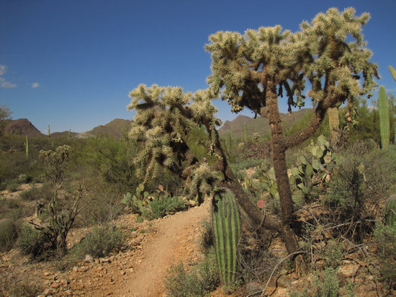
Facilitation and Competition
Competition is an interaction
among two organisms or species that use the same limiting resources (resource competition) or that harm one another in the process of
seeking a
resource
(interference
competition).
Facilitation: positive interactions among plants that occur when the
presence of one plant enhances the growth, survival, or reproduction of a neighbor. Could be bi- or mono-directional.

Slide 16
Secondary succession
- Soil is present. Pulse in nutrient availability
- Colonizers are already present. Resprout from roots and stems. Seed bank or seedling bank.
Change in species composition affected by:
Life-history traits of the colonizers;
Facilitation;
Competitive interactions;
Herbivory & pathogens;
Random processes.

Slide 17
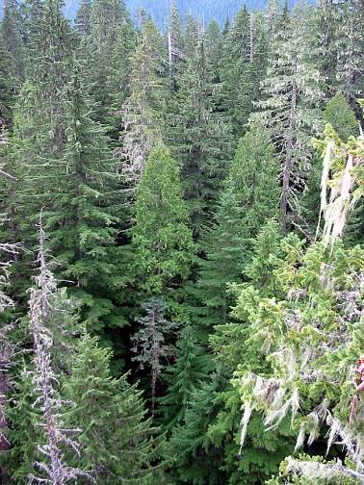
Disturbances - Importance
- Disturbances play a fundamental role in all forest ecosystems
- Disturbances kill few or all trees within a forest stand leaving space and resources for new individuals
- Despite the significance and existence of disturbances were well-known from a long time, their role in the dynamics of forest ecosystems has been recognized only recently (last 2-3 decades).

Slide 18
Disturbances - Importance
Frequency of major disturbances is very low, much lower than the human life span and only recently we have some technical tools available to appreciate and understand these phenomena.
Few and sparse past information
1898 - first commercial broadcasting station
1935 - first commercial TV channel
1962 - first sat TV program
1993 - Internet is public
1938 - Tornado in New England 238000 ha of forest blew down
1980 - St. Helens eruption 70000 ha
1983 - Borneo forest fire 3200000 ha
1987 - Forest fire in Cina 350000 ha
1988 - Yellowstone fire 570000 ha
1991 - Hurricanes Viviane and 1999 Lothar (windthrow > 100 M m³)

Slide 19
Succession: Interactions between Disturbance and Landscape
Disturbance may reset succession or disturbance may advance succession!
Disturbance size and intensity are important to post-disturbance succession because they affect the availability of propagules.
The mosaic created by disturbance will influence secondary succession greatly.
late succession
wind
fire
early succession

Slide 20
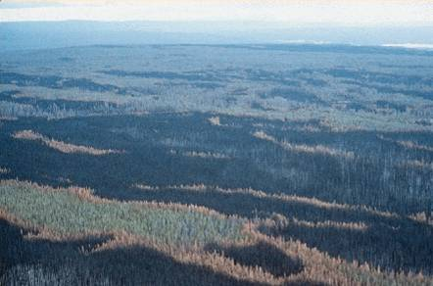
Disturbances – Regime and Properties
The impact of disturbance on ecosystem depends on its properties:
Magnitude ,
Frequency,
Type,
Size,
Etc…..
Together these attributes of disturbance constitute the disturbance regime

Slide 21
Component of a Disturbances Regime
Dist. Rate
Average disturbance rate
i.e. average rate at which trees die or frequency of forest fire.
If rates are high, trees that grow fast and reproduce early are selected.
If rates are very high, never develop trees (shrubs/grasses)
In many forests, average disturbance rate ~1%/yr
Tree death is primarily due to fire, wind or insect.

Slide 22
Component of a Disturbances Regime
Dist. Rate
Intensity Severity
Severity
Degree to which the disturbed vegetation has been damaged and ecosystem properties disrupted (magnitude)
Size is not equal to severity:
can have small severe disturbances or large, mild ones.

Slide 23
Disturbances –Properties
The magnitude has two different meanings:
Intensity: physical force of the event per area per time;
Severity: impact on the organism, community or ecosystem
Considering the magnitude forest disturbances can be classify as:
- minor disturbances: they leave behind much of the previous forest stand
- major disturbances or stand replacing disturbances they withdraw almost all the previous forest stand
There is an inverse relationship between intensity/severity and frequency

Slide 24
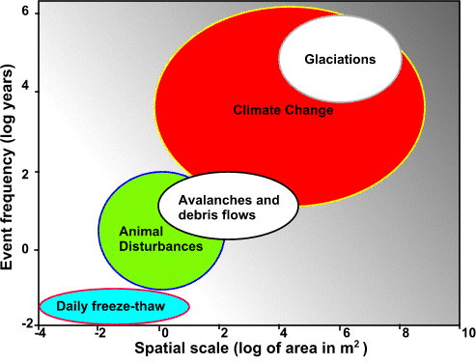
Disturbances –Proprerties
Following Harper (1977):
- disaster, magnitude with a returning time lower than mean stand life span
- catastrophe, magnitude with a returning time higher than mean stand life span

Slide 25
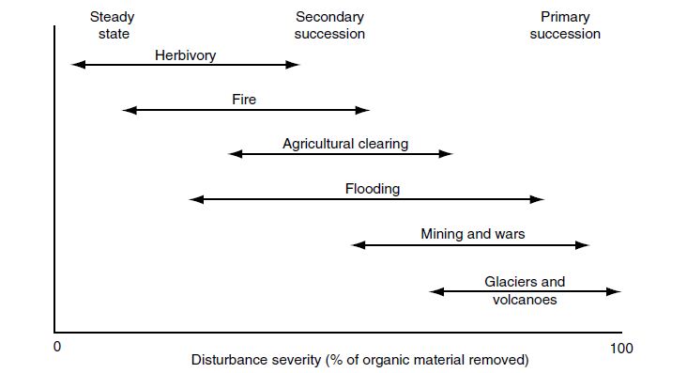
Disturbances Magnitude and Successions

Slide 26
Component of a Disturbances Regime
Dist. Rate
Intensity Severity
Space Size
Distribution in space
Physical environment of the patch varies with size, this leads
1. changes in humidity, light, windspeed, etc.
2. species composition
Smaller disturbance creates smaller patches which will more often promote shade tolerant species

Slide 27
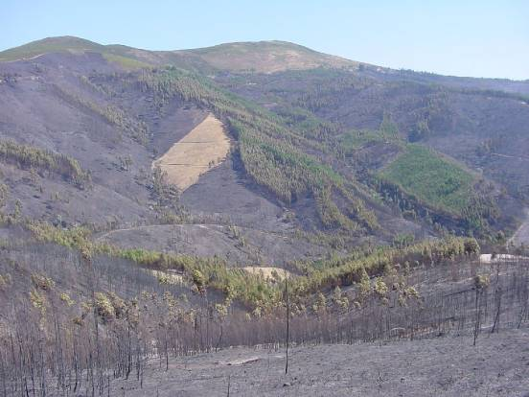
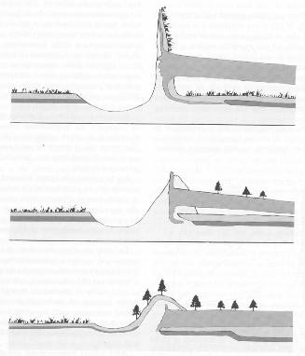
Disturbances –Proprerties
Spatial extension
Disturbance size is highly variable. It can occurs in small gaps created by the death of one or a few plants while some ecosystems develop after stand-replacing disturbances that can be hundreds of square kilometers in area. A disturbance acts rarely evenly: very often we find patches with different intensity/severity within the area affected.

Slide 28
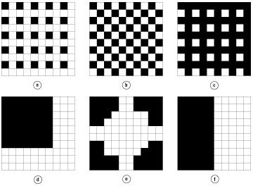
Disturbance and Landscape Interactions
Landscape pattern may affect the spread of disturbances.
Disturbances restricted to one cover type may be slowed by heterogeneity.
Disturbances that spread across cover types may be enhanced by heterogeneity (particularly by edges).
Cannot generalize that effect is to increase or decrease disturbance.
Franklin and Forman: Heterogeneity of forest cutting patterns affects windthrow, fire spread, pathogen spread, and insect damage.

Slide 29
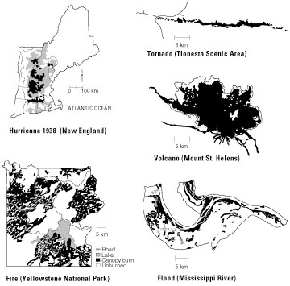
Disturbance and Landscape Interactions
Very different landscape patterns may result from different disturbances.

Slide 30
Component of a Disturbances Regime
Dist. Rate
Intensity Severity
Time
Space Size
Timing
The timing of disturbance often influences its impact.

Slide 31
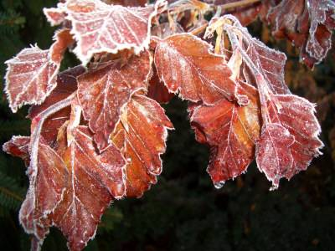
Disturbances –Proprerties
Timing
The timing of disturbance often influences its impact. A strong freeze or fire that occurs during bud break has greater impact than one that occurs two weeks prior to bud break

Slide 32
Component of a Disturbances Regime
Dist. Rate
Recovery rate
Intensity Severity
Time
Space Size
Rates of recovery
How quickly is recovery from a disturbance?
Depends on severity, size and spatial pattern of disturbance.
Often measured by tree growth, sapling height.

Slide 33
Component of a Disturbances Regime
Dist. Rate
Type
Recovery rate
Intensity Severity
Time
Space Size
Disturbance type
It influences ecosystem processes independent of frequency and severity. Organisms adapt to disturbances that occur relatively frequently in their current environment or in their evolutionary past. They are often vulnerable to novel disturbances.

Slide 34
Component of a Disturbances Regime
Dist. Rate
Type
Recovery rate
Intensity Severity
Time
Space Size
Disturbance type
- fire
- wind
- drought
- snow and ice (ice storms)
- avalanches (glaciers)
- floods
- landslide
- volcanoes
animals and pathogens
human activities

Slide 35
Component of a Disturbances Regime
Dist. Rate
Type
Ecosystem Sensitivity
Recovery rate
Intensity Severity
Time
Space Size
Ecosystem Sensitivity
Sensitivity to a particular disturbance type depends on system properties at the time of disturbance.
Species traits (roots depth, frost or drought resistance).
Ecosystem properties (stand structure).

Slide 36
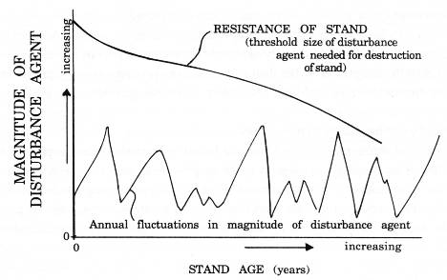
Disturbances – Ecosystem Sensitivity
Forest structure and composition affect the type and extension of the disturbance.
As even-age forest gets older the resistance to disturbance gets lower.
The type and extension of disturbance affect the forest structure and composition:
- Extension and distribution of new space available
- Effect of the near boundaries
- Amount of seed bank and seed dispersal

Slide 37
Component of a Disturbances Regime
Dist. Rate
Type
Ecosystem Sensitivity
Recovery rate
Intensity Severity
Time
Space Size
Biological Legacies
The organisms, organic matter (including structures),
and biologically-created patterns that persist from the pre-disturbance ecosystem and influence
recovery processes in the post-disturbance ecosystem
Legacies

Slide 38
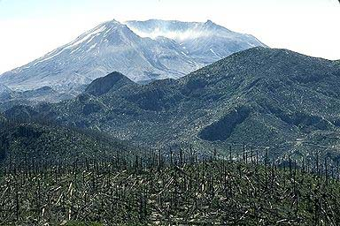
Disturbance and Successions Interactions: Legacies
Persistence of disturbance effects can be for centuries.
Biological Legacies
Propagules. Landscape heterogeneity typically enhances recovery via refugia for propagules (both animal and plant).
Coarse Woody Debris
Successional State. Species composition and demographics.
Mt. St. Helens
Recovery was much faster than expected due to both plant and animal legacies.

Slide 39
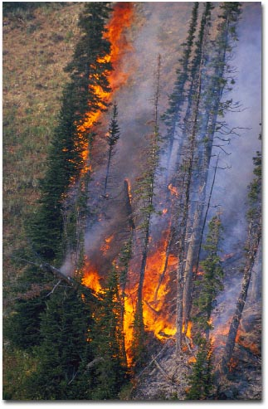
Forest Fire
Fire is the most important and widespread natural disturbance on the Planet. The existence itself of several ecosystems is tightly linked to the recurrence of forest fires.
Fire has been used in different human activities (hunting, pastures mana-gement, deforestation, etc.) and this centuries-long tradition has significantly affected, and is nowadays affecting, forest ecosystems especially in some area (tropics, Mediterranean, SW USA, etc.)

Slide 40
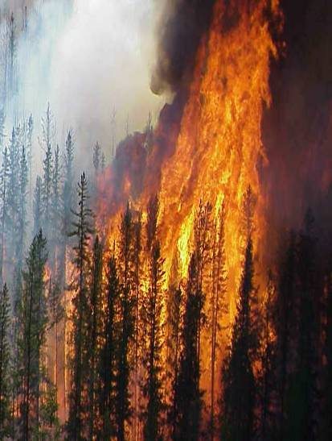
Forest Fire
There is a tight link between frequency and intensity
Surface fire
Crown fire

Slide 41
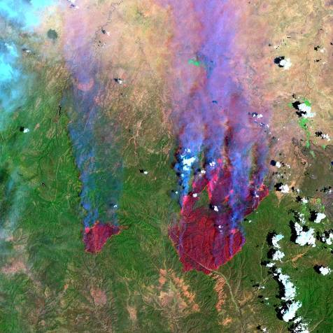
Fire Effects
Physical effects:
Loss of organic matter;
Declining of the structural features of the soil
- Change in soil/stand hydrology;
- Change soil temperature (it can reach shortly as high as 1000°C)

Slide 42
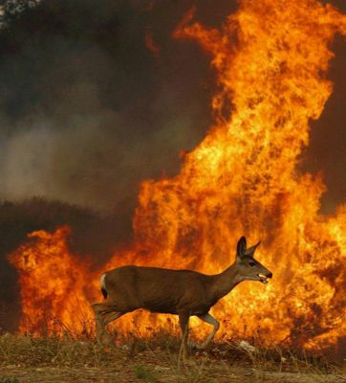
Fire Effects
Chemical effects:
- Increase soil pH
Increase slightly soil fertility but often there is a nutrients leackage
Biological effects:
- Reduction of soil fauna and flora
- Effects on animals and plants

Slide 43
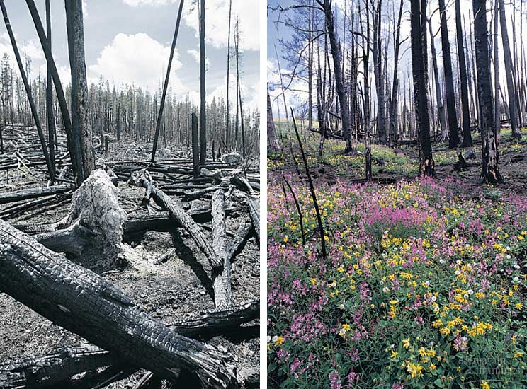
Fire Effects
Short-term effects are almost all negative however on the medium/long-term period the balance is mostly positive:
- Regeneration of the forest
- Pasture available for animals
- Increase the variety of forest composition and structure - biodiversity
- Presence of typical post fire related species
1988
1999
2006

Slide 44
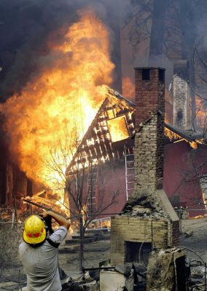
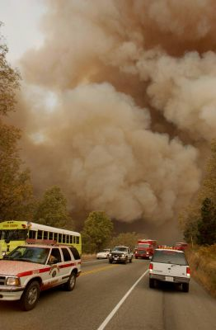
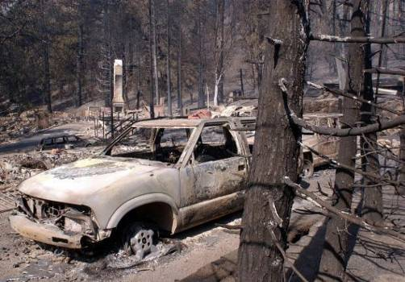
DO NOT MIX UP THE ECOLOGICAL EFFECTS WITH THE SOCIO-ECONOMICAL ONES!!!

Slide 45
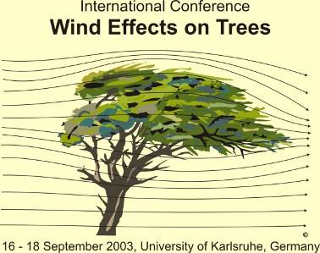
Wind
Wind can cause either the uprooting or the breaking down of a tree (species, wind type)
Wind weakness increases with increasing tree height, age and h/d ratio
Wind is one of the most widespread and known disturbances in the Alps

Slide 46
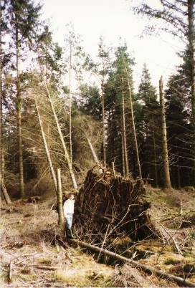
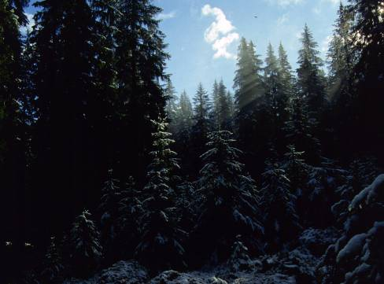
Wind Effects
Wind often acts as a minor disturbance opening small gap within the closed canopy.
This is the main regeneration strategy in the old-growth forests.
Patterns of blowdown strongly influenced by storm meteorology and topographic variation

Slide 47
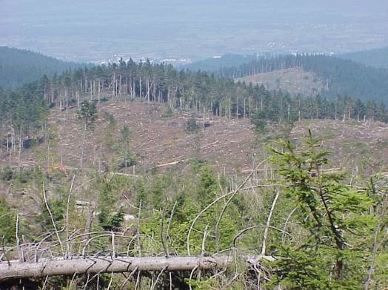
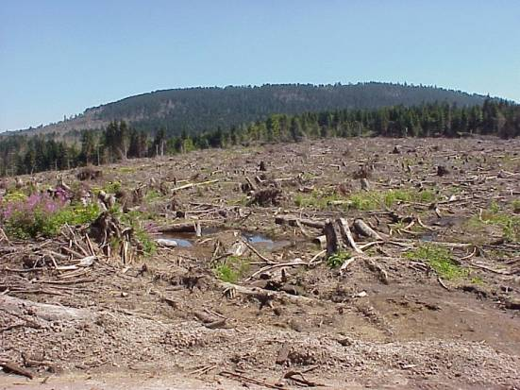
Wind Effects
1991 Hurricane Viviane: 120 M m³
1999 Hurricane Lothar 180 M m³

Slide 48
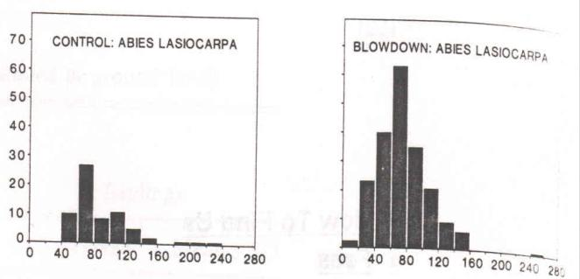
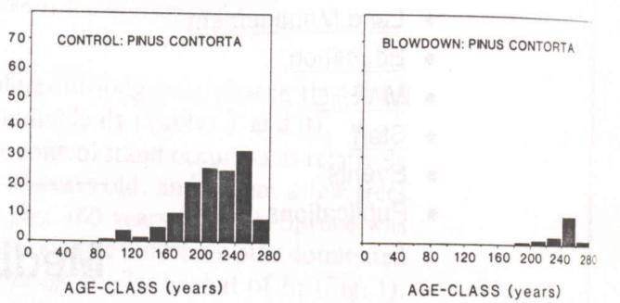
Wind Effects
Effect of blowdown is to accelerate replacement of canopy trees and to create the “Pillow and cradle” topography.
Veblen et al. 1989. Blowdown and stand development in a Colorado subalpine forest. CJFR, 19: 1218-1225.

Slide 49
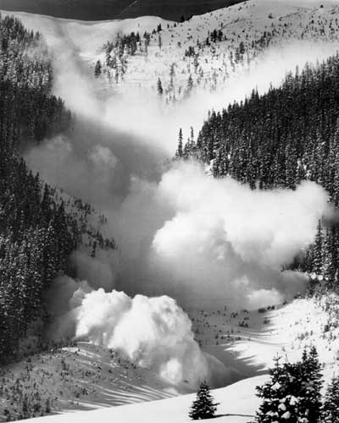
Avalanges and Glaciers Effects
Imbalance between dry slides and wet slides
Where? Slopes > 15° and…..snow

Slide 50
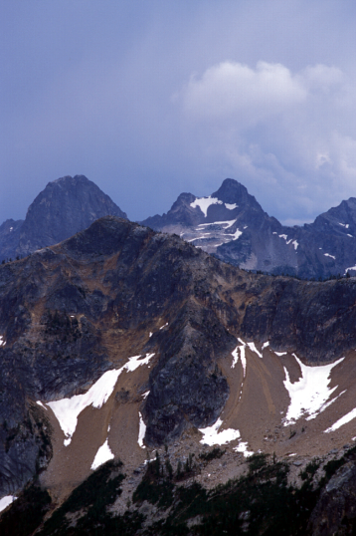
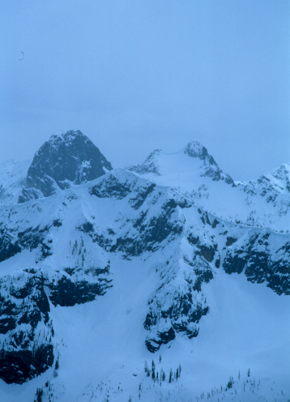
Avalanches and Glaciers Effects
Terrain
+
Weather

Slide 51
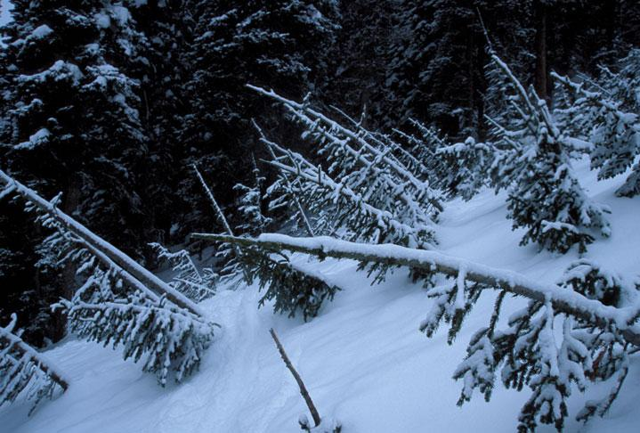
Snow avalanches– individual scale effects

Slide 52
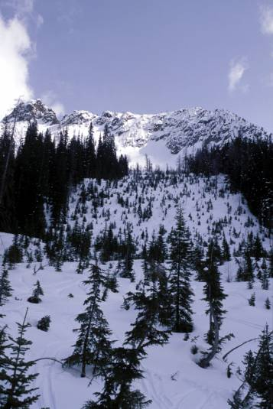
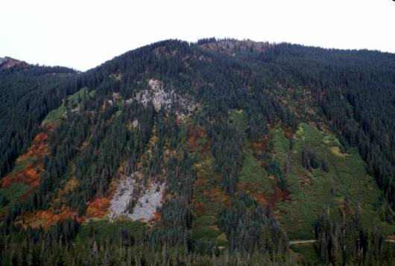
Snow avalanche – community scale effects

Slide 53
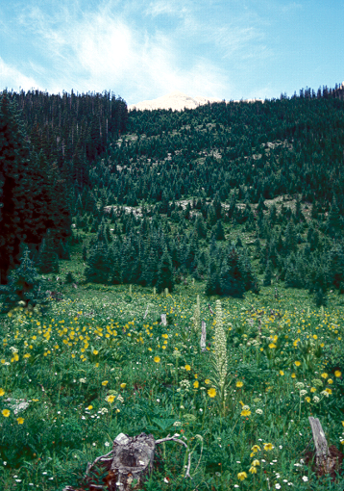
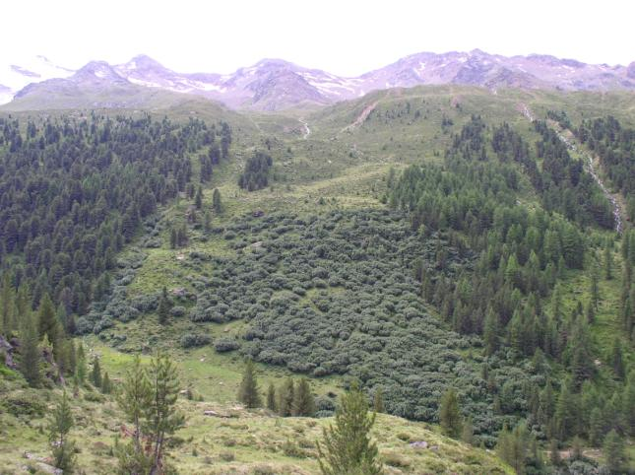
Snow avalanche – community scale effects
Communities within a path are controlled by avalanche frequency
Community stability changes with frequency
frequency < 15-20 yrs. → shrub dominated
special type with alder (Alnus sp.)
frequency > 15-20 yrs. → conifer dominated

Slide 54
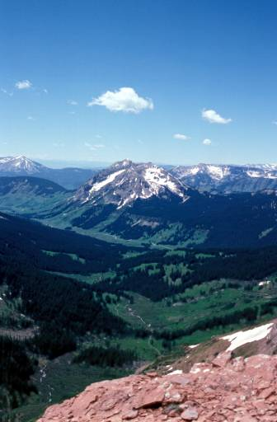
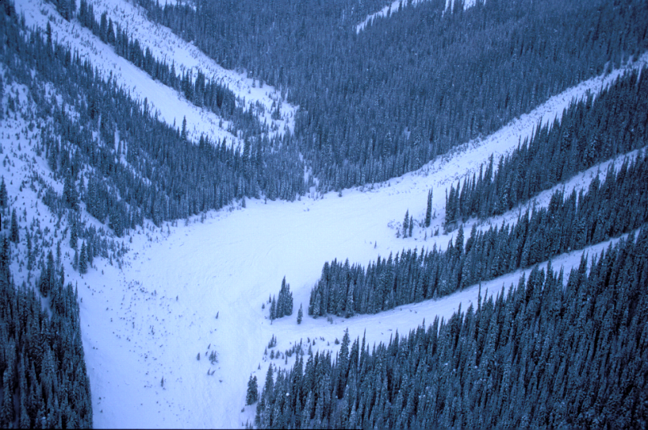
Snow avalanche – landscape scale effects

Slide 55
Snow avalanche – landscape scale effects
Snow avalanches are 2nd most important disturbance
8% of forested area affected
Mt. Rainier
Paradise
Longmire
Hemstrom and Franklin. 1982. Quaternary research 18, 32-51.

Slide 56
Snow avalanche – landscape scale effects
Colorado watershed
9% of forested area affected
Avalanche/rock slides
Veblen et al., 1994, Ecology 82: 125-135

Slide 57
Snow and Ice-storms

Slide 58
Floods and Erosions

Slide 59
Rockfalls and Landslides

Slide 60
Volcanoes

Slide 61
Mount St. Helens – 05.18.1980

Slide 62
Mount St. Helens – 05.18.1980
Direct effects of the eruption:
- 57 people dead
- Death of all big mammals (more than 1.500 deer)
- Complete destruction of 40.000 ha of forest
- Death of 30.000 ha of forest (standing dead trees killed by the burning cloud at 500 °C)

Slide 63
Mount St. Helens – Eruption effests

Slide 64
Mount St. Helens – The recovery
3
3
9
14
6

Slide 65
Mammals and Insects

Slide 66
Insects disturbances
Bark beetles are the most diffuse
triggered by combo. of climate (e.g. mild winters) and blow-downs
can kill most canopy Picea over extensive areas (100,000s ha)
small individuals (<10cm DBH) usually not attacked, nor is Abies
predominate response is release of subcanopy trees
Western Spruce budworm Choristoneura occidentalis
Larch budmoth Zeiraphera diniana

Slide 67
Deer activities
Bark stripping
Browsing
Fraying

Slide 68
Human-activities Disturbances

Slide 69
Human-activities Disturbances

Slide 70
Logging Disturbances

Slide 71
Disturbances Interactions
fire
climate
landform
weather
bark beetles
avalanches
blow down

Slide 72
People have been always looked at forest disturbances with a negative feeling à economy first.
We always have to consider forest disturbances within the right temporal and spatial scale.
We must study and understand forest disturbances. Considering the ecology of the species and the forest dynamics, in the correct perspective the effects are almost always positive.

