Slide 1
Giovanni Bittante L’attività del National Focal Point

Slide 2
After years of steady progress,
recent setbacks In the fight against hunger and malnutrition
arising from the combined effects of high food prices
and the global economic downturn
coupled with the continuing problems of underdevelopment, civil strife, inadequate food supplies, social discrimination and environmental stress, jeopardize the earlier hopes for achieving the poverty, hunger and nutrition-related Millennium Development Goals (MDGs).

Slide 3
According to FAO,
there were 105 million more hungry people in 2009 than in the previous year and the number
of malnourished people now stands at 1.02 billion.
Around the world close to 10 million children die
before their fifth birthday every year, over one-third of which are associated with under nutrition.
One in three developing-country children
under the age of five 178 million children – are stunted
due to chronic under nutrition and poor health,
and some 148 million children are underweight.

Slide 4
Micronutrient deficiencies or “hidden hunger” affects around 2 billion people worldwide
or about one third of the world’s population.
These vitamin and mineral deficiencies,
especially of iron, iodine, zinc and vitamin A,
lead to poor physical growth and development, lowered mental capacities, reduced productivity, impaired immune systems, blindness and death - all of which are preventable.

Slide 5
While the cost of treating and dealing
with the effects of malnutrition,
whether in fiscal, economic or human terms, is high,
the prevention of malnutrition is much less.
Investing in nutrition, therefore,
not only is a moral imperative,
but also makes economic sense
as it reduces health care costs, improves productivity
and economic growth and promotes education, intellectual capacity and social development.

Slide 6
The importance of food-based approaches
for overcoming malnutrition and improving nutrition
is fully recognized by the FAO.
Focusing on the distinctive relationship between agriculture, food and nutrition, FAO works actively to protect, promote and improve established food-based systems as the sustainable solution to ensure food and nutrition security,
combat micronutrient deficiencies, improve diets and raise levels of nutrition, and by doing so,
to achieve the nutrition-related MDGs.

Slide 7
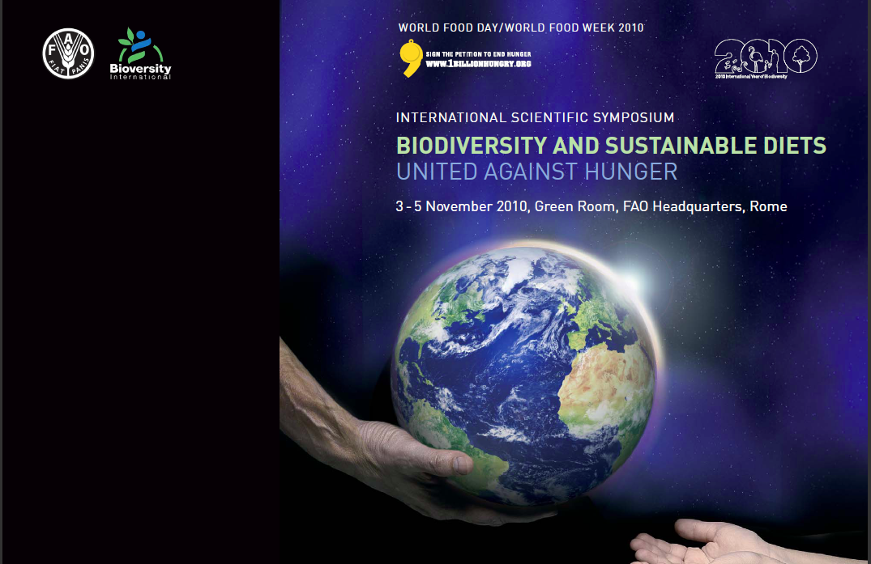

Slide 8
INTERNATIONAL SCIENTIFIC SYMPOSIUM BIODIVERSITY AND SUSTAINABLE DIETS UNITED AGAINST HUNGER 3-5 NOVEMBER 2010 FAO HEADQUARTERS, ROME FINAL DOCUMENT
DEFINITION OF SUSTAINABLE DIETS:
Sustainable Diets are those diets
with low environmental impacts
which contribute to food and nutrition security
and to healthy life for present and future generations.
Sustainable diets are protective and respectful of biodiversity
and ecosystems, culturally acceptable, accessible,
economically fair and affordable;
nutritionally adequate, safe and healthy;
while optimizing natural and human resources.

Slide 9
INTERNATIONAL SCIENTIFIC SYMPOSIUM BIODIVERSITY AND SUSTAINABLE DIETS UNITED AGAINST HUNGER 3-5 NOVEMBER 2010 FAO HEADQUARTERS, ROME FINAL DOCUMENT
3. Decision-makers should give priority to
and promote sustainable diet concepts in policies
and programmes in the agriculture, food, environment,
trade, education and health sectors.
Nutrition should be given more emphasis
by plant and animal breeders
and research on nutrient content of food biodiversity
should be encouraged.
Food composition data should be compiled by FAO
in the INFOODS databases and by regional and national institutions.

Slide 10
INTERNATIONAL SCIENTIFIC SYMPOSIUM BIODIVERSITY AND SUSTAINABLE DIETS UNITED AGAINST HUNGER 3-5 NOVEMBER 2010 FAO HEADQUARTERS, ROME FINAL DOCUMENT
4. New projects and case studies should be encouraged
to demonstrate the synergies between biodiversity,
nutrition and socio-economic, cultural
and environment sustainability
as well as to gather evidence about the potential
of greater use of biodiversity for better nutrition
and health and for poverty alleviation and improved livelihoods.
The evidence gathered from these research efforts
should be compiled by FAO and Bioversity International
and made available on an open access web-based platform.

Slide 11
INTERNATIONAL SCIENTIFIC SYMPOSIUM BIODIVERSITY AND SUSTAINABLE DIETS UNITED AGAINST HUNGER 3-5 NOVEMBER 2010 FAO HEADQUARTERS, ROME FINAL DOCUMENT
5. Food based dietary guidelines and policies
should give due consideration to sustainability
when setting goals aimed at healthy nutrition.
A guidance document on how to develop such guidelines
and policies at national level could be elaborated by FAO,
in collaboration with Bioversity International
and other partners.

Slide 12
INTERNATIONAL SCIENTIFIC SYMPOSIUM BIODIVERSITY AND SUSTAINABLE DIETS UNITED AGAINST HUNGER 3-5 NOVEMBER 2010 FAO HEADQUARTERS, ROME FINAL DOCUMENT
7. The development of a Code of Conduct for Sustainable Diets
is strongly recommended.

Slide 14
Animals
The biodiversity of the 35 or so animal species that have been domesticated for use in agriculture and food production
is the primary biological capital for livestock development
and is vital to food security and sustainable rural development.
Many indigenous breeds, some of which are threatened with extinction,
have characteristics such as resilience to climatic stress and resistance to diseases and parasites, which make them well adapted to local conditions,
and which are of great potential importance to future livestock production.
Recent years have seen substantial erosion of domestic animal diversity a trend that is likely to accelerate
with the rapid changes currently affecting the livestock sector.

Slide 15
Livestock development in the twentieth century
concentrated on a very small number of breeds worldwide,
frequently without due consideration to the way
in which production environments
affect animals’ ability to survive, produce and reproduce.
According to:
The State of the World’s Animal Genetic Resources
for Food and Agriculture (2007),
20 percent of documented livestock breeds
are at risk of extinction:
1500 of the 7600 breeds around the globe
may be lost forever in the near future.

Slide 16
In order to safeguard and support
world’s agri-cultural heritage systems
FAO launched in 2002 during the World Summit
on sustainable Development (WSSD, Johannesburg, 2002)
a UN Partnership Initiative on conservation
and adaptive management of
Globally Important Agricultural Heritage Systems (GIAHS).
The initiative seeks to promote the international recognition, dynamic conservation of these agricultural heritage systems
—including where necessary their revitalization—
and the outstanding role these systems
played in the maintenance and in-situ conservation
of agricultural biodiversity of global significance.

Slide 17
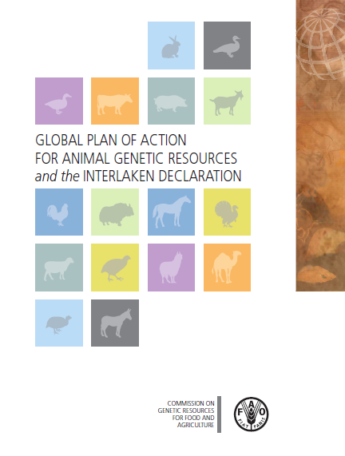

Slide 19
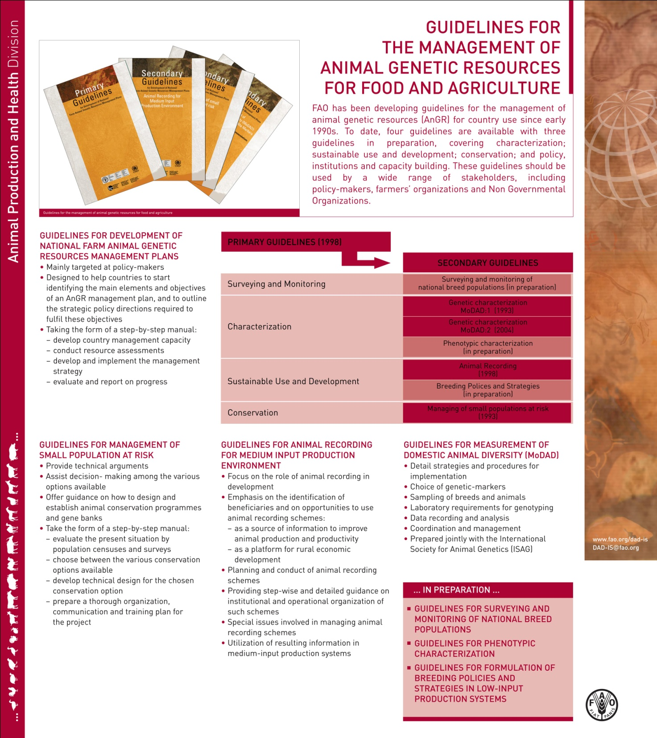

Slide 20
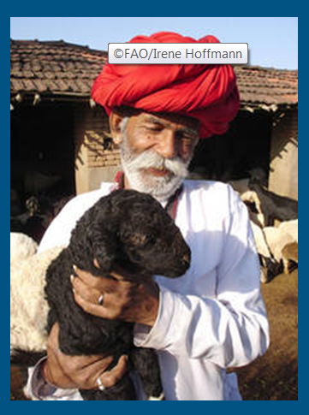
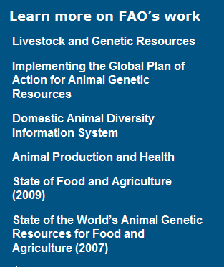

Slide 21
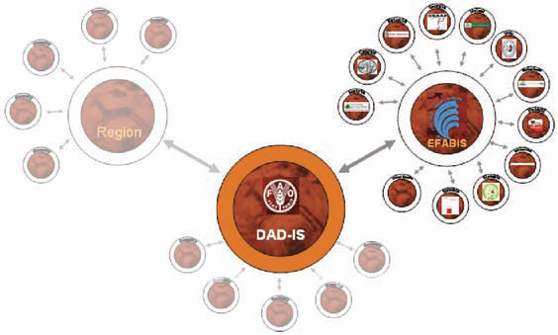
FIGURE 1: structure of the global network

Slide 24
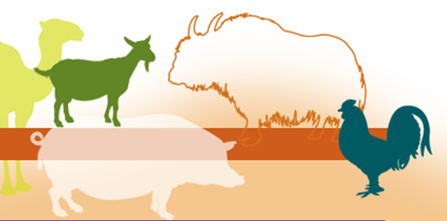

Slide 25
Razze/popolazioni allevate: RUMINANTI
Specie | Italia | Europa | Mondo | I/E | I/M
Bufalo | - | 16 | 174 | - | -
Bovini | 61 | 957 | 3040 | 6,4% | 2,0%
Yak | - | 2 | 27 | - | -
Pecore | 84 | 1138 | 2371 | 7,3% | 3,5%
Capre | 54 | 332 | 1183 | 16,3% | 4,6%
Cervi | - | 20 | 62 | - | -

Slide 26
Razze/popolazioni allevate: MONOGASTRICI
Specie | Italia | Europa | Mondo | I/E | I/M
Asini | 15 | 54 | 189 | 27,8% | 7,9%
Cavalli | 34 | 745 | 1401 | 4,6% | 2,4%
Maiali | 45 | 485 | 1330 | 9,3% | 3,4%
Conigli | - | 305 | 511 | - | -
Cavie | - | - | 19 | - | -
Cani | - | 40 | 52 | - | -

Slide 27
Razze/popolazioni allevate: CAMELIDI
Specie | Italia | Europa | Mondo | I/E | I/M
Cammelli | - | 4 | 16 | - | -
Dromedari | - | 1 | 98 | - | -
Alpaca | - | - | 10 | - | -
Guanaco | - | - | 3 | - | -
Lama | - | - | 8 | - | -
Vigogna | - | - | 4 | - | -

Slide 28
Razze/popolazioni allevate: AVICOLI
Specie | Italia | Europa | Mondo | I/E | I/M
Polli | 6 | 1103 | 2315 | 0,5% | 0,3%
Faraone | - | 10 | 64 | - | -
Tacchini | - | 90 | 179 | - | -
Anatre | - | 161 | 363 | - | -
Anatre mute | - | 10 | 50 | - | -
Oche | - | 165 | 253 | - | -

Slide 29
Razze/popolazioni allevate: SELVAGGINA
Specie | Italia | Europa | Mondo | I/E | I/M
Piccioni | - | 32 | 72 | - | -
Quaglie | - | 12 | 52 | - | -
Fagiani | - | 5 | 18 | - | -
Pernici-starne | - | 3 | 13 | - | -
Pavoni | - | - | 1 | - | -
Rondini | - | - | 1 | - | -

Slide 30
Razze/popolazioni allevate: RATITI
Specie | Italia | Europa | Mondo | I/E | I/M
Struzzi | - | 5 | 22 | - | -
Emu | - | 1 | 5 | - | -
Casuari | - | 1 | 2 | - | -
Nandu | - | 1 | 3 | - | -
Tinamou cileno | - | - | 1 | - | -

Slide 31
 | ASINI:
 | Asino Albino
 | Asino dell'Amiata
 | Asino dell'Asinara
 | Asino di Pantelleria, Pantesco
 | Asino Grigio Siciliano
 | Asino Sardo
 | Asino Sardo Grigio Crociato
 | Baio Lucano
 | Cariovilli (extinct)
 | Grigio viterbese (extinct)
 | Martina Franca
 | Ragusano
 | Romagnola (extinct)
 | Romagnolo
 | Sant'Alberto (extinct)

Slide 32
CAVALLI:
 | Asino Baio Lucano | Cremonese (extinct)
 | Avelignese | Delta
 | Avelignese Tradizionale | Italiano da Sella
 | Calabrese | Lipizzano
 | Cavallino di Monterufoli | Maremmano tradizionale
 | Cavallo Agricolo Italiano | Napoletano
 | Cavallo anglo-arabo-sardo | Persano
 | Cavallo Bardigiano | Pony dell'Esperia
 | Cavallo Del Catria | Pugliese (extinct)
 | Cavallo della Giara | Puro Sangue Orientale
 | Cavallo Del Ventasso | Quarter Horse
 | Cavallo Maremmano | Salernitano
 | Cavallo Murgese | Samolaco
 | Cavallo Norico | Sanfratellano
 | Cavallo Pentro | Sarcidano
 | Cavallo Sardo | Tolfetano
 | Cavallo Siciliano | Trottatore Italiano

Slide 33
 |  | BOVINI:
 | Abruzzese (extinct) | Grigia alpina | Pisana
 | Agerolese | Grigia di Val d'Adige (extinct) | Podolica
 | Bardigiana (extinct) | Grigia di Val di Fiemme (extinct) | Pontremolese
 | Bianca Val Padana | Grossetana (extinct) | Pugliese del Veneto (extinct)
 | Bruna Italiana | Jersey | Pustertaler Sprinzen
 | Bruna Italiana Vecchio Ceppo | Limousin | Reggiana
 | Burlina | Lucana (extinct) | Rendena
 | Cabannina | Marchigiana | Romagnola
 | Calabrese (extinct) | Maremmana | Romana (extinct)
 | Calvana | Modenese | Sarda
 | Camandona (extinct) | Modicana | Sardo Bruna
 | Carniella (extinct) | Mölltal (extinct) | Sardo-modicana
 | Charolais | Montana | Sicilian
 | Chianina | Oropa | Valdarno (extinct)
 | Chianino-Maremmana | Ossolana (extinct) | Val di Chiana (extinct)
 | Cinisara | Pasturina | Valdostana Castana
 | Demonte (extinct) | Perugina (extinct) | Valdostana Pezzata Nera
 | Frisona | Pezzata Rossa Italiana | Valdostana Pezzata Rossa
 | Frisona Italiana | Piemontese | Valtarese (extinct)
 | Friuli (extinct) | Pinzgauer | Varzese Ottonese
 | Garfagnina

Slide 34
PECORE:
 | Alpagota | Cornella Bianca | Massese | Sambucana (Demontina)
 | Altamurana | Cornetta (extinct) | Matesina | Sampeierina
 | Appenninica | Corniglio | Merinizzata Italiana | Sarda
 | Bagnolese | Delle Langhe | Moscia Leccese | Savoiarda
 | Barbaresca campana | Fabrianese | Nera di Arbus | Schwarzbraune Bergsch.
 | Barbaresca Siciliana | Finarda | Nobile di Badia | Sciara (extinct)
 | Bellunese | Frabosana | Nostrana | Sopravissana
 | Bergamasca | Friulana (extinct) | Noticiana | Steinschaf
 | Biellese | Garessina | Noventana (extinct) | Tacola
 | Borgotarese (extinct) | Garfagnina Bianca | Paduan (extinct) | Tiroler Bergschaf
 | Brentegana | Gentila di Lucania (ext.) | Pagliarola | Trimeticcia di Segezia
 | Brianzola | Gentile di Calabria (ext.) | Pavullese (extinct) | Turchessa
 | Brigasca | Gentile Di Puglia | Pecora di Corteno | Tyrol Mountain
 | Brogne | Istriana | Pinzirita | Urbascia (extinct)
 | Cadorina (extinct) | Lamon | Plezzana | Valle del Belice
 | Carapellese (extinct) | laticauda | Pomarancina | Varesina
 | Carnica (extinct) | Leccese | Pusterese | Vicentina (Foza)
 | Ciavenasca | Livo (extinct) | Quadrella | Villonesser Schaf
 | Cinta (extinct) | Locale | Razza di Garessio | Vissana
 | Ciuta (extinct) | Maremmana (extinct) | Rosset | Zerasca
 | Comisana | Marrane | Saltasassi | Zucca Modenese (ext.)

Slide 35
 |  | CAPRE:
 | Alpina | Di L'Aquila | Passeirer Gebirgziege
 | Argentata dell'Etna | Di Montecristo | Pomellata
 | Bianca Monticellana | Di Potenza | Potentina
 | Bionda dell'Adamello | Di Salerno | Roccaverano
 | Bormina | Di Teramo | Rossa Mediterranea
 | Camosciata delle Alpi | Frisa valtellinese | Rustica di Calabria
 | Capestrina | Garganica | Saanen
 | Capra dell'Aspromonte | Girgentana | Sarda
 | capra pezzata mochena | Grigia molisana | Sarda di Tavolara
 | Cilentana Fulva | Istriana | Sarda Primitiva
 | Cilentana Grigia | Jonica | Screziata
 | Cilentana Nera | Lariana o Di Livio | Sempione
 | Ciociara Grigia | Maltese | Val Di Livo (extinct)
 | Delle Tremiti | Messinese | Valdostana
 | Derivata di Siria | Napoletana | Valfortorina
 | Di Benevento | Nera dei nebrodi | Valgerola
 | Di Campobasso | Nicastrese | Vallesana
 | Di Cosenza | Orobica o Valgerola | Verzaschese

Slide 36
 |  | MAIALI:
 | Abruzzese (extinct) | Fumati (extinct) | Nero Siciliano
 | Apulo Calabrese | Gargano (extinct) | Parmigiana Nera
 | Basilicata (extinct) | Garlasco (extinct) | Perugina (extinct)
 | Bastianella (extinct) | Hampshire | Pietrain
 | Bergamasca nera | Lagonegrese (extinct) | Pugliese
 | Borghigiana (extinct) | Landrace Belga | Reggitana (extinct)
 | Casertana | Landrace Italiana | Riminese (extinct)
 | Catanzarese (extinct) | Large White | Rossa modenese (extinct)
 | Chianina (extinct) | Macchiaiola Maremmana | Samólaco (extinct)
 | Cinta Senese | Mora Romagnola | San Lazzaro (extinct)
 | Cosentina (extinct) | Murgese (extinct) | Sarda
 | Duroc | Napoletana Fulva | Siciliano
 | Faentina (extinct) | Nero dei Lepini | Spotted
 | Forlivese (extinct) | Nero dei Monti Dauni Meridionali | Suino delle Nebrodi e Madonie
 | Friulana nera (extinct) | Nero Reatino | Valtellina (extinct)

Slide 37
POLLI:
 | Ancona
 | Livorno
 | Padovana
 | Polverara-Schiatta
 | Siciliana
 | Valdarno

Slide 39
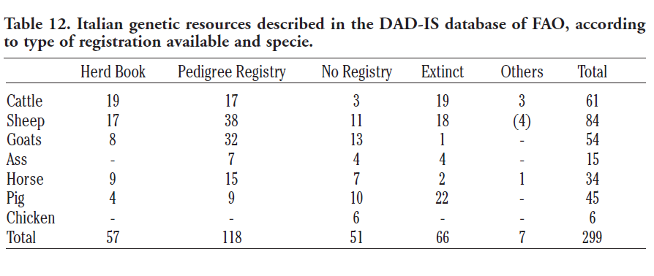

Slide 40
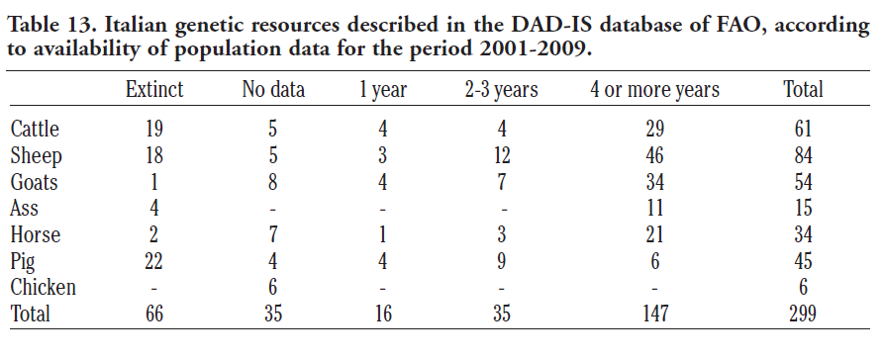

Slide 41
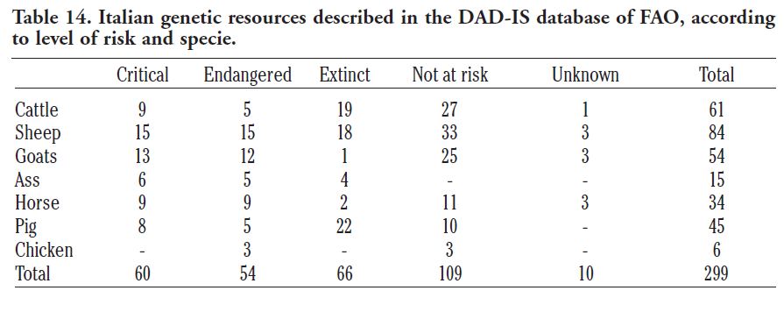

Slide 42
AZIONI PRIORITARIE:
Indagine – monitoraggio;
Caratterizzazione della razza:
genetica/genomica;
fenotipica;
ambientale;
culturale;
Conservazione ex situ:
Criobanca virtuale;
Conservazione in situ:
Piano di accoppiamenti;
Promozione della razza;
Valorizzazione dei prodotti;
Valorizzazione ambientale;

Slide 43
CONCLUSIONI:
Le razze si salvano salvando prima di tutto gli allevatori;
Bisogna abbandonare la cultura della produttività a tutti i costi;
Ci vuole un approccio globale con coinvolgimento degli stakeholders;
È necessario un approccio di sistema “from field to fork”;
C’è bisogno di coordinamento e informazione;

Slide 44
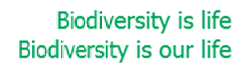
CONCLUSIONI:
È un lavoro importante:
Possiamo farlo;
Dobbiamo farlo!
Grazie !

