Slide 1
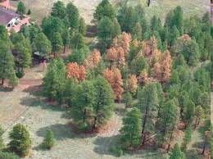
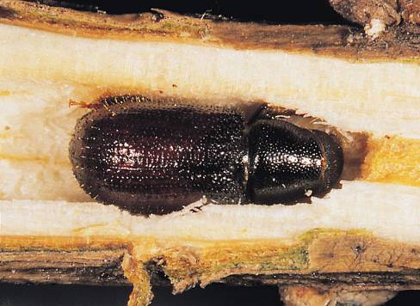
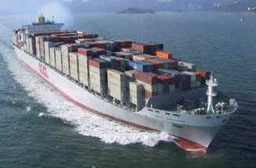
Exploring the effects of trade and environment on exotic Scolytinae (Coleoptera) invasions
Marini et al. (2011) Biological Invasions

Slide 2
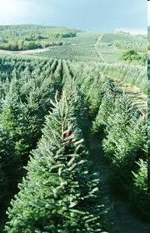
Introduction: Alien scolytid invasions
● Bark and ambrosia beetles (Coleoptera: Curculionidae: Scolytinae) are amongst the most important pests causing significant economic damage to forest trees worldwide
● In the past few decades, establishment of alien species has steadily increased in both Europe and North America
● Alien species might have important ecological and economic impacts

Slide 3
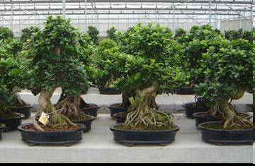
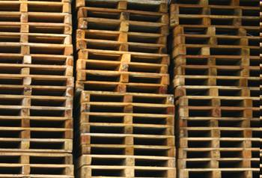
Introduction: Alien scolytid pathways
International trade facilitates the spread of these pests given that scolytids can move:
● in the actual product being transported (e.g., nuts, seeds, logs, lumber, nursery stock)
● in the associated wood packing material or dunnage, or
● as hitchhikers on ships. containers, and airplanes
Unlike plants, insects are mostly introduced
accidentally

Slide 4
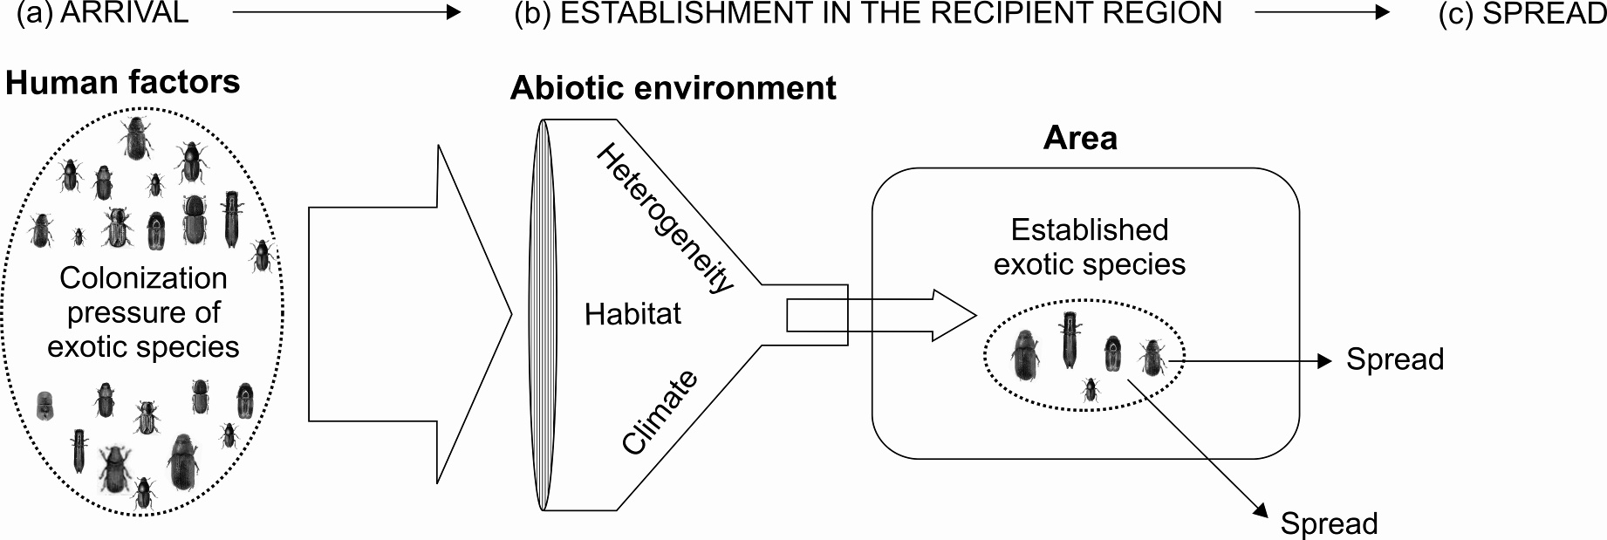
Introduction
Is introduction effort more important than local conditions?
Import
Trade
Recipient country/state

Slide 5
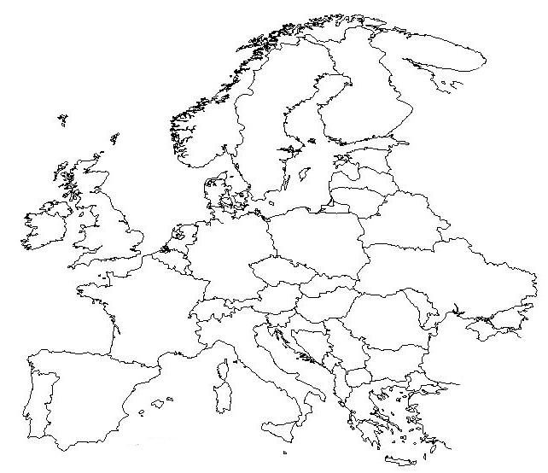
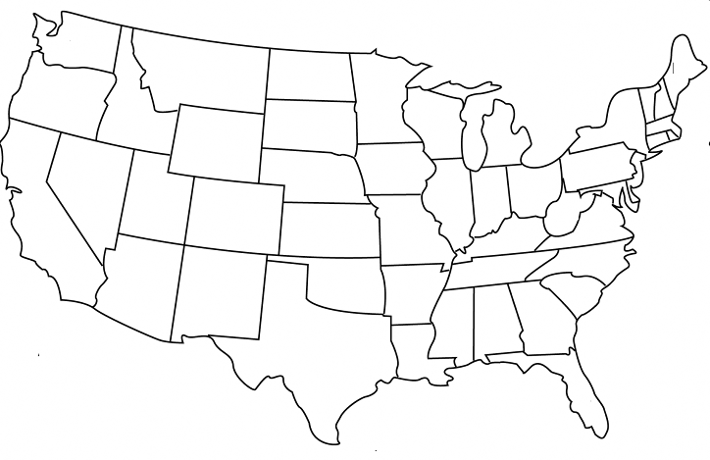
Methods: data
Study area: continental USA and Europe
Response variable: Number of native and alien species established in each state/country
Predictors: Two groups of variables:
Economy (Import): proxy for colonization and propagule pressures
Environment of the recipient region (forest area, temperature, rainfall, forest diversity, climatic heterogeneity)

Slide 6
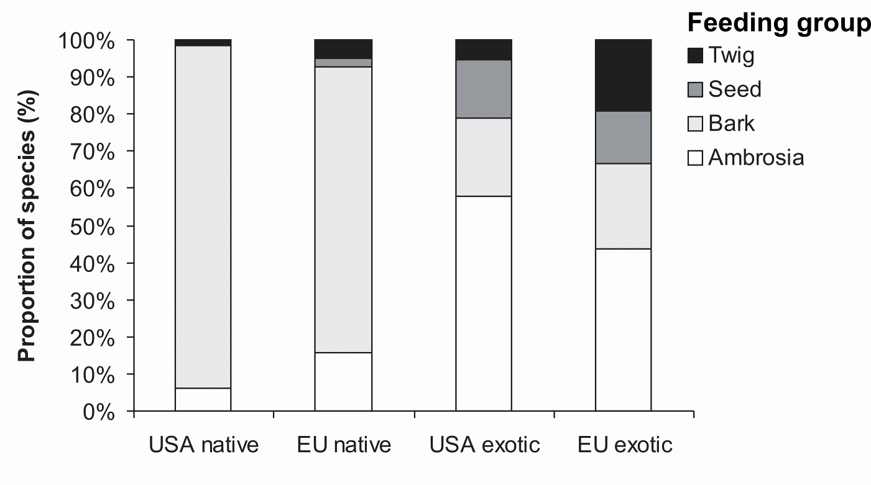
General results: feeding strategies
n=469
n=223
n=57
n=20
Aliens more frequently Ambrosia than natives
Level of invasion (alien/native)~10-15%
US native
EU native
US alien
EU alien
Ambrosia life-history traits favoring invasion:
haplodiploidy, i.e. the ability to produce male offspring without mating,
sib-mating, i.e. brother-sister mating prior to emergence from the host tree,
symbiotic trophic specialization with fungi that obviates the need to overcome many host defenses, and
low host specificity and ability to breed in dead wood

Slide 7
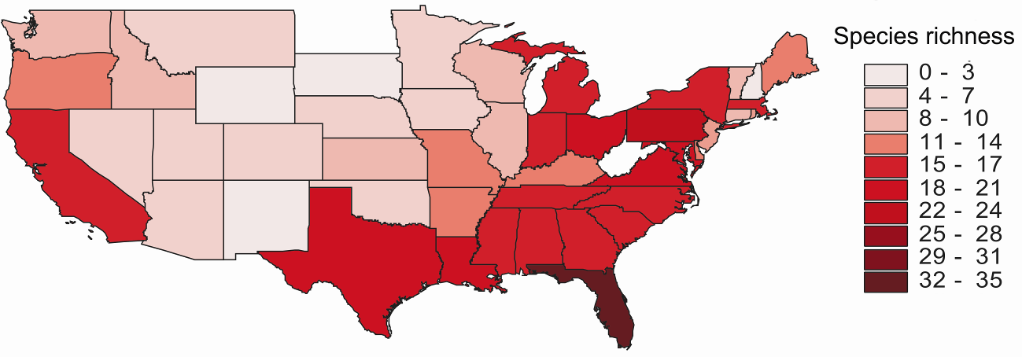
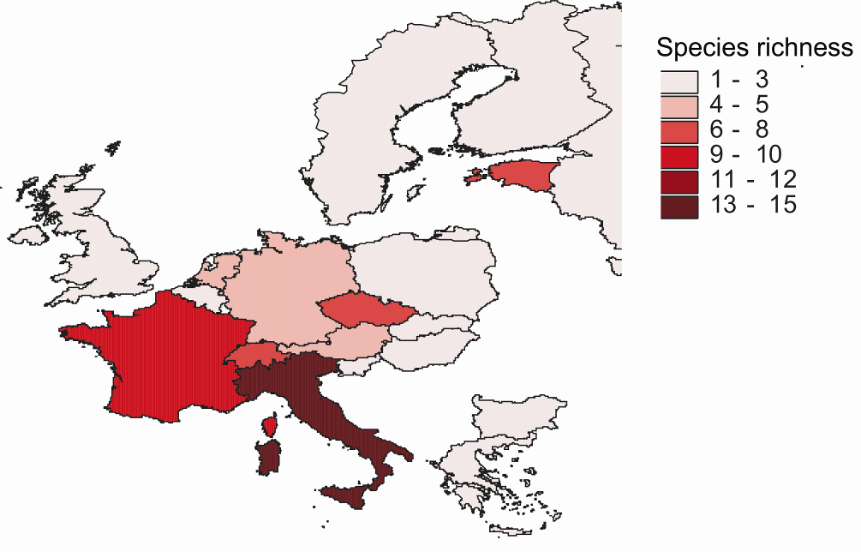
General results: alien species invasion
Much higher diversity of alien species in the USA than EU
Higher levels of exotic invasions in the USA than EU

Slide 8
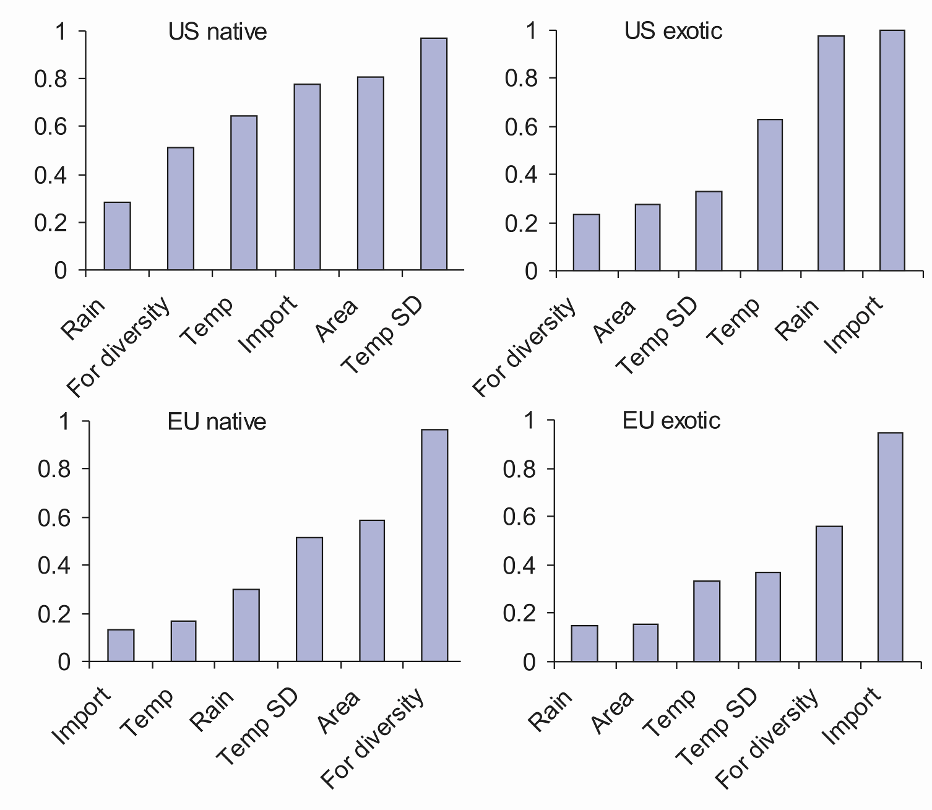
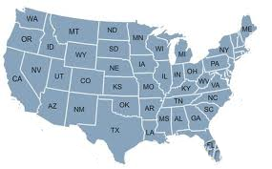
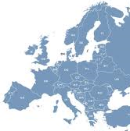
Relative importance of the drivers
US native
US alien
Sum of model weights (w_{i})
EU native
EU alien

Slide 9
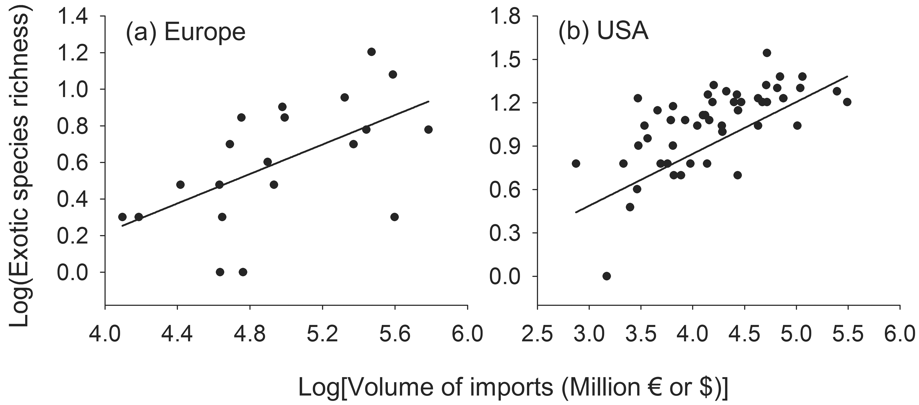
Alien richness patterns: Import
€€€ The consequences of being rich $$$:
The more you introduce the more you get
Amongst our 6 variables IMPORT was always the best predictor

Slide 10
Exotic richness patterns: Climate
Climate was less important in Europe than in the USA
Does feeding strategy modify species richness response to climatic gradients?
Ambrosia
Ambrosia
Species richness
OR
Bark
?
Bark
Rainfall
Temperature
Rainfall
Temperature
Test was possible only in the USA (no enough species in EU)

Slide 11
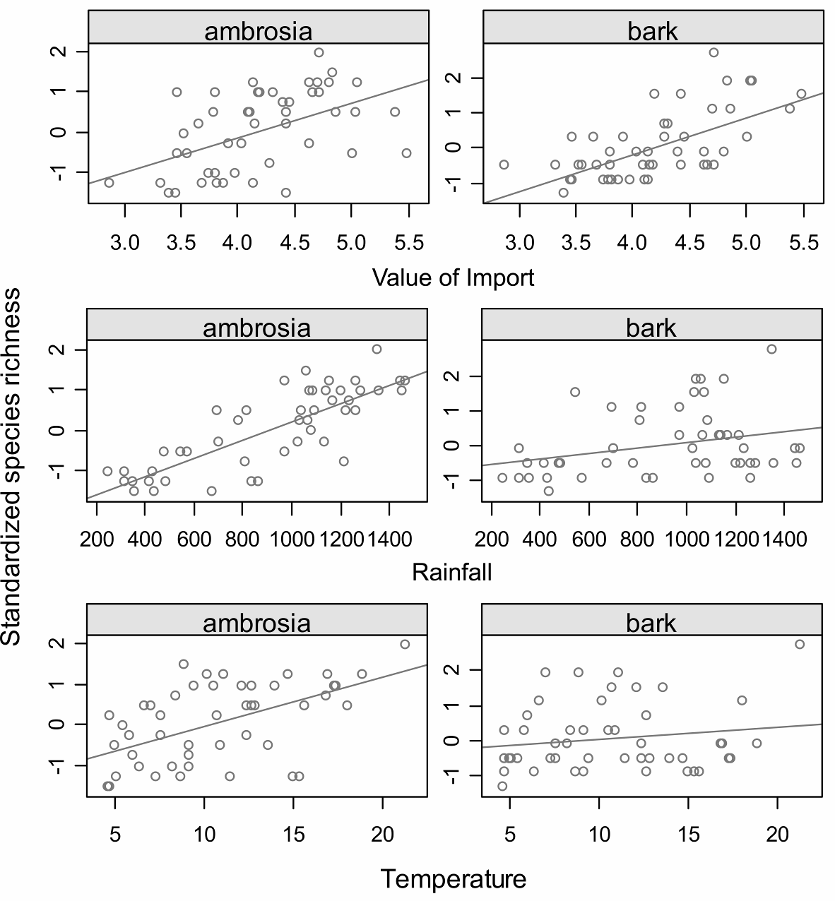
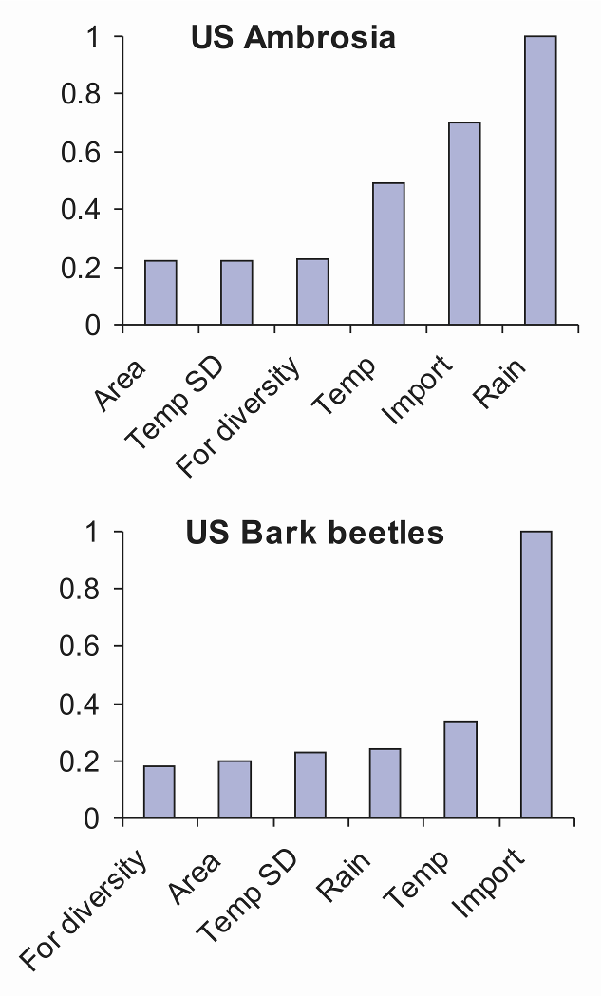
Ambrosia vs. bark beetles
Sum of model weights (w_{i})

Slide 12
Conclusions
● Our study suggests that growing international trade is the primary factor contributing to escalating rates of scolytid invasions worldwide
● Climate and land-use effects are of secondary importance
● More attention is needed to prevent or reduce the arrival rate of alien species through international trade
● Although international standards have been implemented, individual countries can further reduce the likelihood of establishment and spread of exotic organisms through pest and pathway risk assessments, improved inspection techniques, and early detection surveys

Slide 13
Main question addressed in the seminar
Is introduction effort more important than the quality of the recipient regions?
In most cases yes!
Pyšek et al. PNAS (2010)

