Slide 1
Forest Hydrology: Lect. 18
Contents
Report 1: Posina Flood event analysis and modelling
see:
SCS - Curve Number method
Application of the SCS – CN method at hourly steps
Data (excel file)
Report template
.

Slide 2
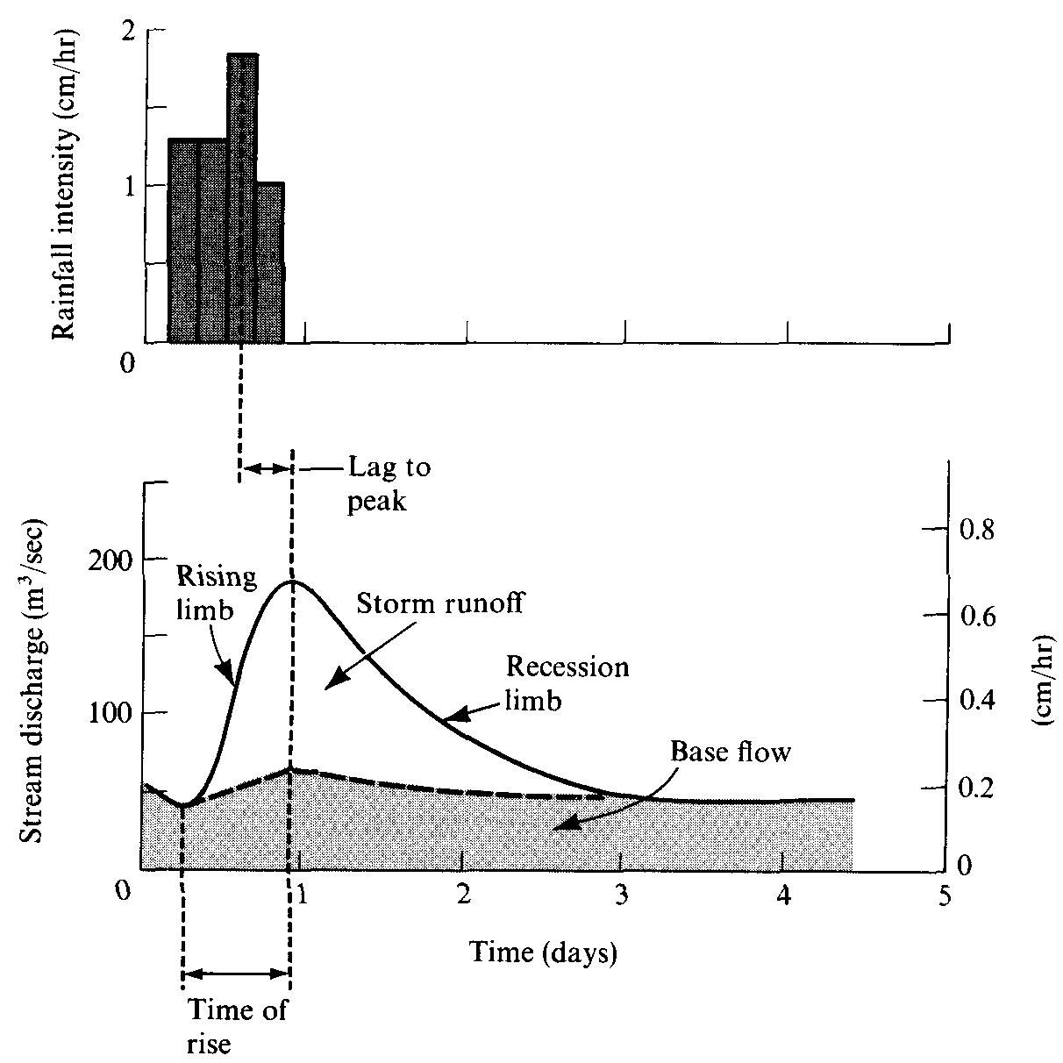
The flood and its hydrograph
Terminology Streamflow (runoff) = storm runoff + baseflow or quickflow + delayed flow Flood runoff coefficient= (event runoff)/(event rainfall)

Slide 3
Prediction of watershed runoff (i.e.: computing the flood event runoff coefficient)
What do we want to know? Total volume of storm runoff given the rainfall
Soil Conservation Service Method (Curve Number)
Very widely used in prediction software
Accounts for effects of soil properties, land cover, and antecedent soil moisture
Prediction of storm flow depends on total rainfall rather than intensity
Based on a very simple conceptual model, as follows.

Slide 4
Prediction of storm runoff volume (‘SCS’ method) All quantities expressed in mm of water
Total precipitation, P, is partitioned into:
An initial abstraction, I_{a} , the amount of storage that must be satisfied before any flow can begin. This is poorly defined in terms of process, but is roughly equivalent to interception and surface depression that occurs before runoff.
Thus, [P – I_{a}] is the ‘excess precipitation’ (after the initial abstraction) or the ‘potential runoff’.
Retention, F, the amount of rain falling after the initial abstraction is satisfied, but which does not contribute to the storm flow. This is equivalent to volume of water that is infiltrated.
Storm runoff R_{s}

Slide 5
It is assumed that a watershed can hold a certain maximum amount of precipitation, S_{max}
(1)
where F∞ is the total amount of water retained as t becomes very large (i.e. in a long, large storm).
It is the cumulative amount of infiltration
It is also assumed that during the storm (and particularly at the end of the storm)
(2)

Slide 6
The idea is that “the more of the potential storage that has been exhausted (cumulative infiltration, F, converges on S_{max}), the more of the ‘excess rainfall’, or ‘potential runoff’, P-I_{a}, will be converted to storm runoff.”
The scaling is assumed to be linear.
One more relationship that is known by definition (balance):
(3)
Combination of these leads to
(4)

Slide 7
Another generalized approximation made on the basis of measuring storm runoff in small, agricultural watersheds under “normal conditions of antecedent wetness” is that
(5)
The few values actually tabulated in the ‘original’ report are 0.15-0.2 S_{max}.
Thus
(6)

Slide 8
Combination of these relations yields
(7)
for all P > I_{a} . ELSE R = 0.
Thus, the problem of predicting storm runoff depth is reduced to estimating a single value, the maximum retention capacity of the watershed, S_{max}.

Slide 9
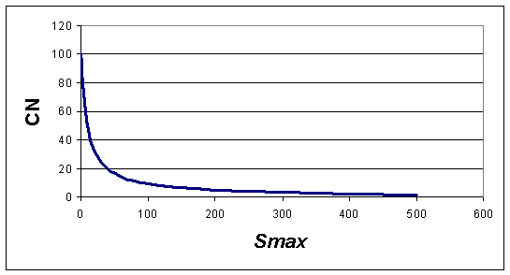
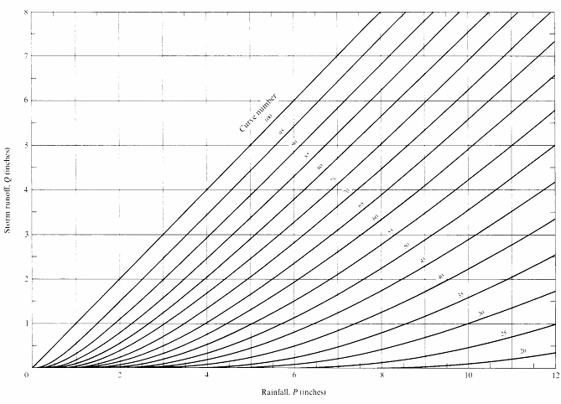
The parameter S_{max} (mm) is related to a parameter called the Curve Number, which is an index of “storm-runoff generation capacity”, varying from 0 to 100.
Relationship between rainfall and runoff (in depth) for a given event

Slide 10
The entire rainfall-runoff response for various soil-plant cover complexes is represented by the Curve Number (large oversemplification!).
A higher curve indicates a large runoff response from a watershed with a fairly uniform soil with a low infiltration capacity.
A lower curve is the smaller response expected from a watershed with a permeable soil, with a relatively high spatial variability in infiltration capacity.

Slide 11
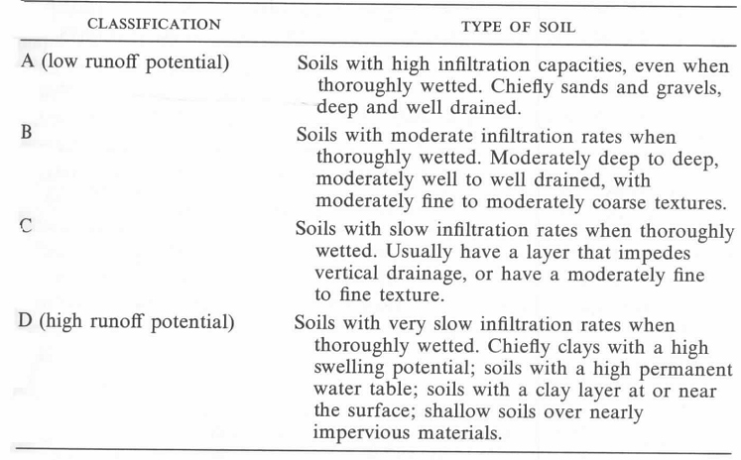
CNs are evaluated for many watersheds and related to:
soil type (SCS soil types classified into Soil Hydrologic Groups on the basis of their measured or estimated infiltration behavior)
vegetation cover and or land use practice
antecedent soil-moisture content
Hydrologic Soil Groups are defined in SCS Soil Survey reports

Slide 12
Classification of hydrologic properties of vegetation covers for estimating curve numbers (US Soil Conservation Service, 1972)

Slide 13
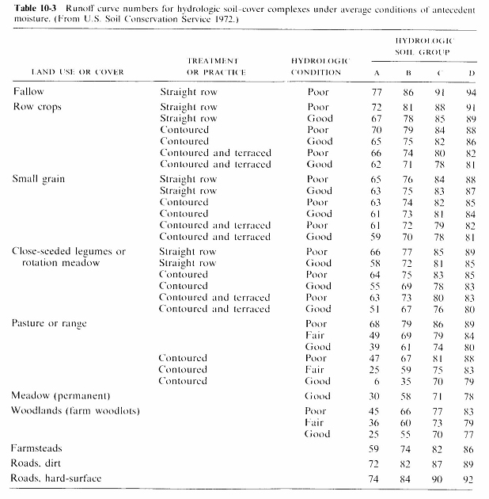
Runoff Curve Numbers for hydrologic soil-cover complexes under average antecedent moisture conditions

Slide 14
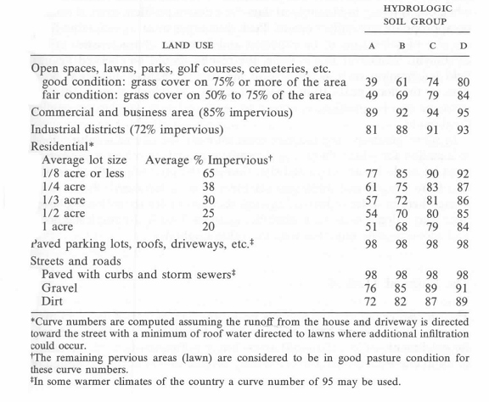
Curve Numbers for urban/suburban land covers (US Soil Conservation Service , 1975)

Slide 15
Accounting for the Antecedent Moisture Condition
The previous table permit the computation of a CN which is valid for an average AMC (Antecedent Moisture Condition). It is possible to adapt the method to varying AMC based on the AMC category defined in Table 1, and then computing the corresponding CN values based on the relationships for CN(I) (valid for AMC-I) and CN(III) (valid for AMC-III).

Slide 16
Example
It is required to compute the runoff depth (in mm and in cubic meters) for a 20 km² catchment and for a storm event given by the following hyetograph (the hyetograph is the record of rainfall with time for a given storm):
hour 1: 20.0 mm
hour 2: 35.0 mm
hour 3: 15.0 mm
Use the CN method (curve number), taking a value of 60 for the CN.

Slide 17
Esercise (2)
The SCS method allows one also to compute the runoff at each time step (i.e., not only at the event time scale).
To this end, the SCS relationship is applied at each time step in terms of cumulative quantities, and then subtracting at each time step the cumulative quantities computed at the previous time step.

Slide 18
Example
It is required to compute the runoff depth (in mm and in cubic meters) for a 20 km² catchment and for a storm event given by the following hyetograph (the hyetograph is the record of rainfall with time for a given storm):
hour 1: 20.0 mm
hour 2: 35.0 mm
hour 3: 15.0 mm
Use the CN method (curve number), taking a value of 60 for the CN.

Slide 19
Esercise (3)

Slide 20
Application
Examining the hydrologic consequences of an extreme storm event
in Este (31.05.1995)
catchment: 70 ha
Rainfall depth: 199.8 mm
(in two events: 1°: 58.2 mm;
2°: 141.6 mm)
CN(II) catchment: 72
CN(I): 58
CN(III): 86
for 1° event: condition AMC I; for 2° event AMC III
1° event
2° event

Slide 21
Esercise (4)
Four raingauges measures rainfall during one storm event.
The measured rainfall depths and the Thiessen factors (for a given catchmet) for each raigauge are as follows:
Raingauge 1: 35 mm Thiessen weight=0.2
Raingauge 2: 45 mm Thiessen weight=0.2
Raingauge 3: 85 mm Thiessen weight=0.2
Raingauge 4: 10 mm Thiessen weight=0.4
The catchment is characterised by a CN=75, Ia = 0.2 S, and it is 50 km² wide.
Compute the runoff depth, in mm and in m³.

Slide 22
Estimation of S based on observed values of rainfall and runoff
For a given pair of runoff (Q) and rainfall (P) event-cumulated values, the value of the potential retention S is obtained as follows:
where Ia is the multiplicative parameter of the initial abstraction
(usually taken at 0.2).
Then the value of curve number (CN) may be obtained based on the value of S.

